Slide 1
Igniting Big Imaginations
Working Together to Grow Children's Theatre
The evaluation story
16 March 2018

Slide 2
The core objectives of the Consortium are:
1) Audiences: To develop and nurture longer-term
relationships with audiences and market a programme
of touring work for children and families in order to ensure
as many people as possible experience and are inspired by great art.
2) Promoters: To drive and strengthen a consortium and touring circuit in the North West enabling quality children’s shows to come to the region more readily, making it more cost-effective and sustainable.
3) Artists: To develop and nurture longer-term relationships with artists making excellent work for children, specifically work of a diverse nature to reflect the communities we serve.
4) To support and encourage cross-venue partnership working to support and share resources and skills, developing CPD for children’s theatre especially in the areas of programming, marketing and audience development, by visiting festivals and showcases and sharing best practice.

Slide 3
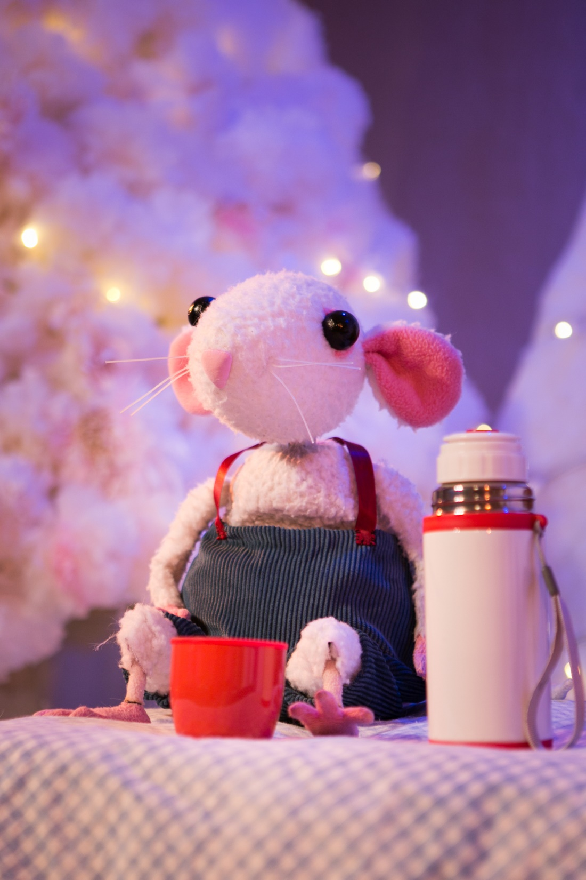
Evaluation strands
Running a Successful Consortium
Investment in Programming and Quality
Audience Impact
Challenges and lessons learnt

Slide 4
Evaluation Framework
Peer Learning & Awareness
Annual Benchmark on impact / awareness on wider sector
Impact on Consortium members
Annual Consortium Focus Group
Annual measuring Artistc Standards questionnaire
Audience Impact
Family focus groups (in-house by each venue at start of 2015 / repeat end of 2017)
Annual Mystery Shopper exercise
Co-commissioning Impact
Final Evaluation report
Evaluation done by Consortium members with artists, audiences and partners
Collation of three years analysis and Annual summary reports into final Evaluation report
Evaluating the Impact on Young People 8-13 (Developing & piloting approach)
Online Audience Performance review questionnaire - ongoing
Audience data analysis - Box Office figures
Log approaches for advice/information on children's theatre received by Consortium members
Annual Quantitative Benchmarking on agreed KPIs and individual SMART targets

Slide 5
In a nutshell…
“Big Imaginations has brought our venue alive with the sound of children’s laughter on theatre events - it has allowed us to programme high quality theatre and fill our space with small children again, without the consortium's support this would not have been possible.”

Slide 6
Running a Successful Consortium
“Big Imaginations was our first foray into working collaboratively as part of a network and we couldn't have anticipated how rewarding we would find this. We have loved building relationships with other members of the consortium and have reaped the benefits of being part of a bigger conversation about quality children's programming and audience development. The generosity with which colleagues in the network have shared their knowledge and experience has helped us focus on issues like quality and accessibility and fed into our wider ethos and ambitions as an organisation.”

Slide 7
Creating value in the Network
Importance of a co-ordinating organisation
Being aware of time commitment needed to contribute to the Consortium
Recognising its about collaboration not competition
Value in Economies of Scale
Extending the reach and learning
beyond members

Slide 8
Take-away points for running a successful Consortium
Time
Learn from others
Know what you want to achieve in the first place
Manage your network with transparency and fairness
Be clear about agreed expectations from members
Plan in regular points for reflection and evaluation

Slide 9
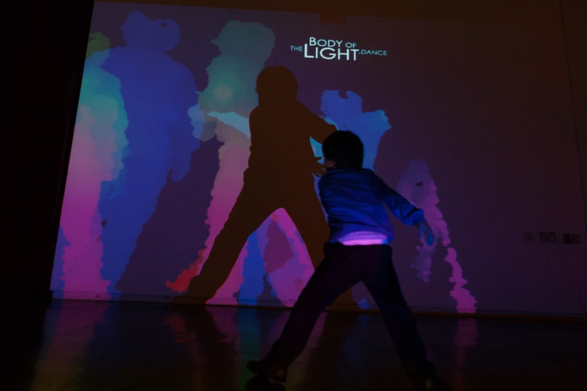
Investment in programming
and quality

Slide 10
Programming and Quality
The importance of the subsidy
The importance of forward planning
Consistent quality assessment
Value of Commissions
Adventures of Pom
Sponge
Adrift
You, Me & i

Slide 11
Big Imaginations Festival 2017 Outcomes
5,003 people attended Big Imaginations Festival 2017.
1,713 audience members took part in 76 wraparound activities that accompanied the shows.
21% of survey respondents hadn’t been to children’s theatre at any of the festival venues before

Slide 12
The Creative Case…
94% of partners say the Festival developed their thinking about how diverse work can be a standard part of their future programming, and 63% of partners reported increased diversity among their audiences.

Slide 13
Festival 2017 - Audience Profile
Ethnic breakdown | Big Imaginations respondents | Population of the North West (ONS data)
White ethnic group | 79.8% | 90.2%
Asian / Asian British | 7.7% | 6.2%
Mixed / Multiple ethnic groups | 7.1% | 1.6%
Chinese / Chinese British | 2.0% | no ONS figure available
Black / African / Caribbean / Black British | 1.7% | 1.4%
26% of audiences (369 respondents) surveyed had not attended children’s theatre in the last 12 months.
42% of audience respondents said they had attended the same venue to see children’s theatre before. This means that potentially an estimated 58% were first-time children’s theatre attendees at the specific venue that surveyed them.
90% of audiences surveyed said the Festival encouraged them to attend other children’s shows in future.
78% of respondents gave a rating of ‘brilliant’; 20% gave a rating of ‘good’.

Slide 14
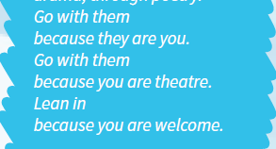
Audience Impact

Slide 15
Audience data
Number of Shows Big Imaginations partners programmed 71 shows titles in 2014; 39 in 2015; 31 in 2016; and 29 in 2017.
Number of Performances: The number of performances offered varied across the three years, with a dip in 2016:
2014: 490 performances
2015: 224 performances
2016: 197 performances
2017: 210 performances
Audiences:
2014 - 32,607
2015 - 20,424
2016 - 16,101
2017 - 21,162
Big Imaginations has consistently attracted first-time attendees to children’s theatre across phase 2, with between 20% and 27% of attendees being first-timers in each year.

Slide 16
Participation
Participation target - 477
4,454 participations in 2015
4,373 in 2016
8,923 in 2017 when the Big Imaginations Festival took place

Slide 17
Legacy of Big Imaginations for audiences
A wider choice of shows brought to the region, including more 'risky' work
A wider choice of where to see children's theatre
A wider offer for age ranges that were previously limited i.e. early years and 7+
Programming dates for children's theatre bring extended from the typical Saturday/ Sunday programme

Slide 19
Challenges in running Big Imaginations
Capacity required to run the Network – both by the lead organisation and members
Commissions taking more time than expected generally and trying to balance this against on-going programming
Capacity of partners to achieve their audience development plans with overly ambitious SMART targets

Slide 20
Lessons learnt
Benchmark in advance of starting
Be clear with members about how much time needs to be allocated to get benefits out of it
Partner relationship management takes time – have a clear plan for how to co-ordinate your Consortium and drive activity
Maximise the skills partners bring to the Consortium
Consider the ‘fit’ of programming choices as widely as possible – physically and demographically

Slide 21
Ways you can succeed too…
Consider alternative funding options:
Approach trusts as a group or smaller clusters
Non-NPOs could lead on Grants for Arts bids but work in partnership with NPOs that can’t apply
Venues directly contributing cash to realise some of the desired objectives
Sponsorship of discreet areas such as accessibility
Focus on activity that doesn’t require significant funding
Sharing knowledge/ CPD between venues
Joint data analysis or evaluation
Consider how to use other assets such as your space to support artists in R7D stage
Work together to develop a showcase
Cross promote each others work

Slide 23
“The value of the Big Imaginations Consortium cannot be underestimated.
It has bewitched and beguiled the youngest of children.
It has entertained and surprised parents and grandparents.
It has impressed and inspired teachers.
It has instilled pride in our staff and delivered something truly special and unique into a town with no theatre.
Big Imaginations? It's certainly taught us to imagine a different way of delivering touring theatre and has almost certainly fed the imaginations of hundreds of children.”

